Slide 1
C++ High Performance

Slide 2
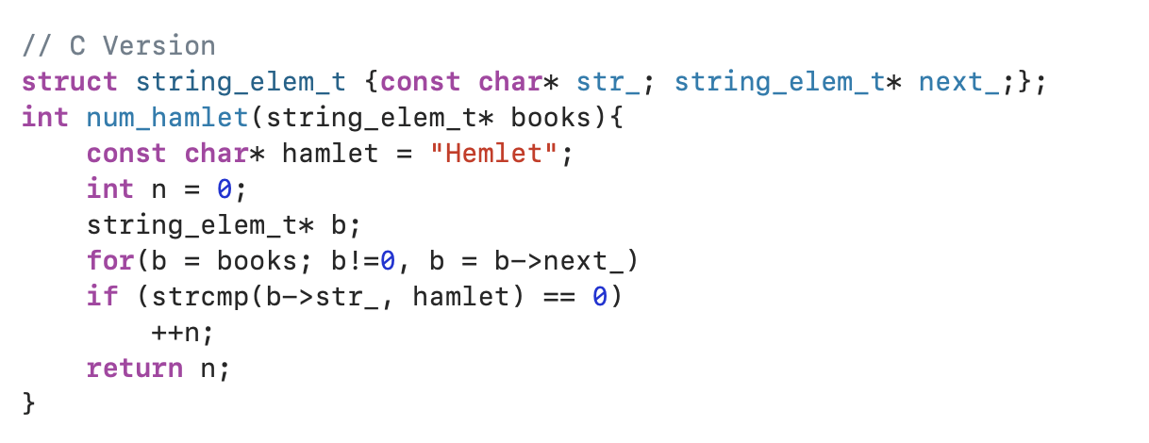
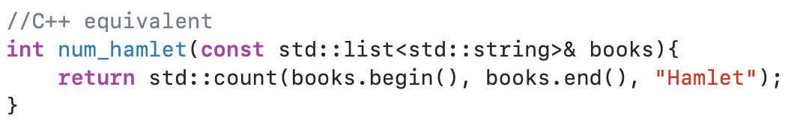
Why C++?
C++ is a highly portable language which offers zero-cost abstractions.
C++ provides programmers with the ability to write and manage large, expressive, and robust code bases.
Pointers to raw memory addresses are not visible at all
Abstraction
String_elem_t
For loop and if-condition
Char* and strcmp
Notes:
The more developers working on a code base, the larger the code base becomes. We need abstractions such as functions, classes, data structures, layers, and so on in order to manage the complexity of a large-scale code base. But constantly adding abstraction and new levels of indirection comes at a price – efficiency. This is where zero cost abstractions play its role. A lot of abstractions offered by C++ comes at a very low price. At a minimum, C++ offers efficient alternatives at hot spots where performance really is a concern.

Slide 3
Abstractions
C++ classes are abstractions of C-structs and regular functions.
C++ polymorphism is the abstraction of function pointers.
C++ lambda functions are abstraction of C++ classes.
Templates are abstractions of generating C++ code.

